Slide 1

BANDRIVE AUTO
Finance - Stocks Canada
How Does the Stock Market Work?

Slide 2
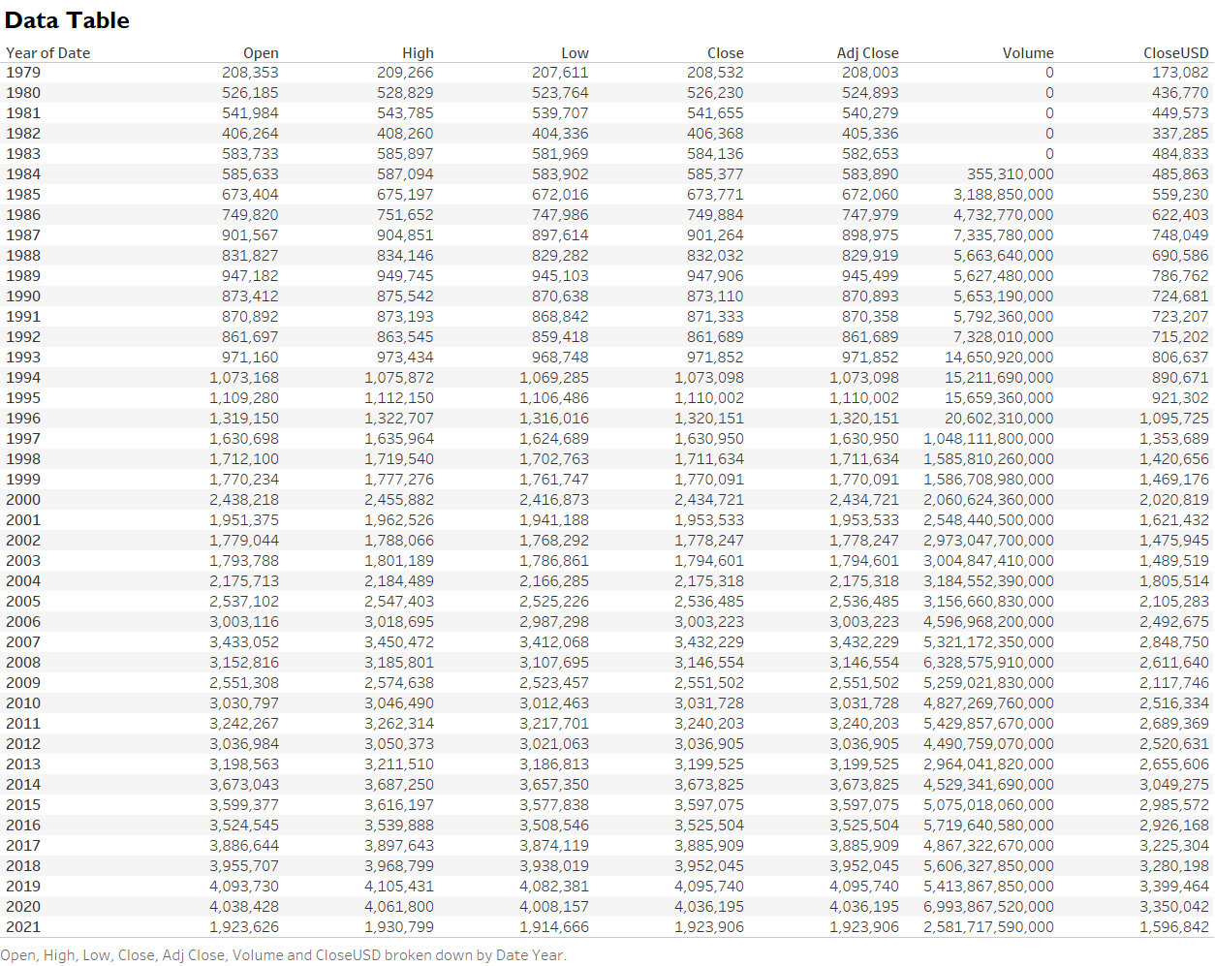
21ST Century (2001 – 2021) data we will be focusing on.

Slide 3
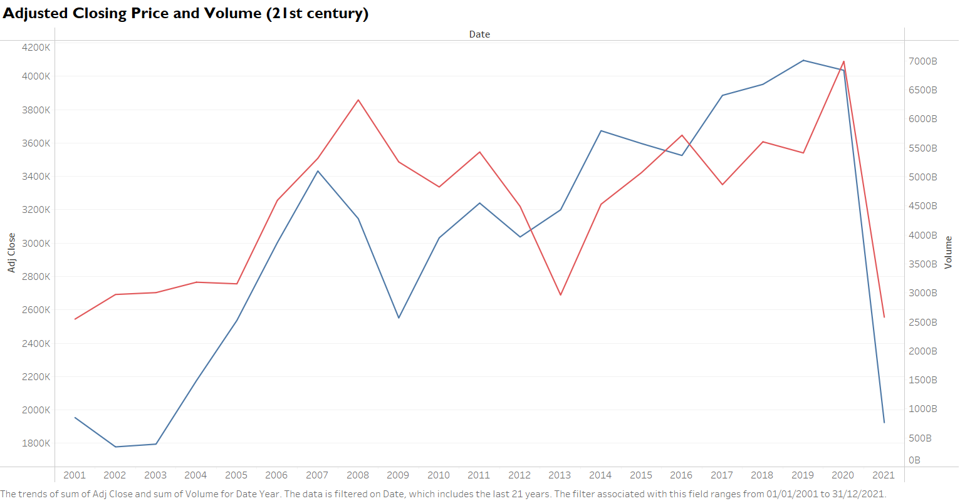
TSX Adjusted Closing Price and Volume (21st Century)
2020
2008
The dashed mark compare and shows the drop in Adj Closing price in 2008 & 2020.

Slide 4
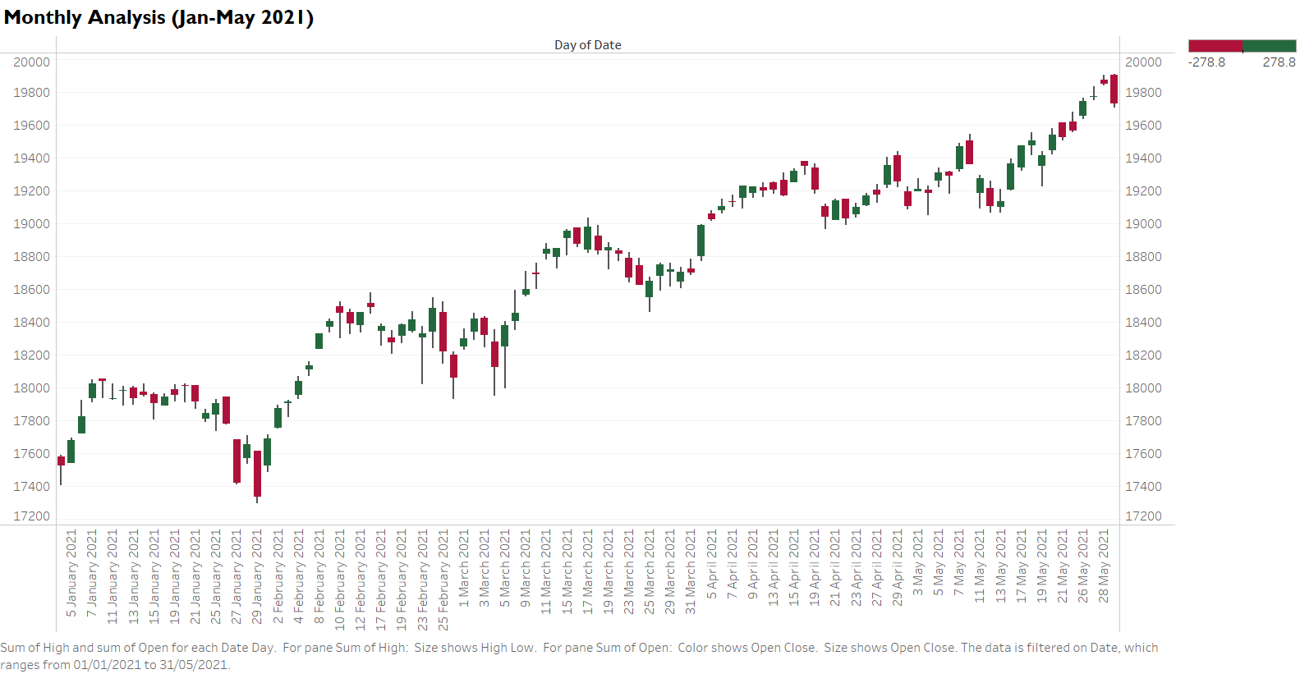
High
Close
Open
Close
Open
Low
The labeled marks shows the four (4) important measures in designing a stock chart.

